Slide 1


Data Science Capstone Project
Minwuye Mesfin
August 20,2025

Slide 2
Outline
Executive Summary
Introduction
Methodology
Results
Conclusion
Appendix

Slide 3
Executive Summary
Summary of methodologies
Summary of all results
Data collection
Data wrangling
Exploratory Data Analysis with Data Visualization
Exploratory Data Analysis with SQL
Building an interactive map with Folium
Building a Dashboard with Plotly Dash
Predictive analysis (Classification)
Exploratory Data Analysis results
Interactive analytics demo in screenshots
Predictive analysis results

Slide 4

Introduction
Project background and context
SpaceX has revolutionized commercial space travel by reducing launch costs through reusable Falcon 9 first stages.
Key Questions
How do factors like payload mass, launch site, flight count, and orbit affect landing success?
Has the success rate improved over time?
Which algorithm works best for this binary classification?
A launch costs $62M compared to $165M from other providers, mainly due to reusability. Predicting whether the first stage will land helps estimate launch costs.
Using public data and machine learning, we aim to model this outcome.

Slide 5

Methodology
Data Collection
Gathered data using the SpaceX REST API.
Complemented information through web scraping from Wikipedia.
Data Wrangling
Filtered and cleaned the collected datasets.
Handled missing values to maintain data integrity.
Applied One-Hot Encoding to transform categorical features for binary classification tasks.
Exploratory Data Analysis (EDA)
Conducted analysis using visualization techniques and SQL queries.
Identified key trends and insights through graphical exploration.
Interactive Visual Analytics
Built interactive visualizations with Folium for geospatial insights.
Used Plotly Dash to create dynamic dashboards.
Predictive Analysis
Developed and evaluated classification models for predictive tasks.
Applied techniques for model tuning to optimize performance.
Assessed models to ensure accuracy and reliability of results.

Slide 6

Data Collection
Data Sources and Features
From SpaceX REST API:
FlightNumber
Date
BoosterVersion
PayloadMass
Orbit
LaunchSite
Outcome
Flights
GridFins
Reused
Legs
LandingPad
Block
ReusedCount
Serial
Longitude
Latitude
From Wikipedia Web Scraping:
Flight No.
Launch site
Payload
PayloadMass
Orbit
Customer
Launch outcome
Version Booster
Booster landing
Date
Time
The data was collected through a combination of API requests from the SpaceX REST API and web scraping from the SpaceX Wikipedia entry.
Using both methods ensured the dataset was comprehensive and provided detailed information about launch events for analysis.

Slide 7
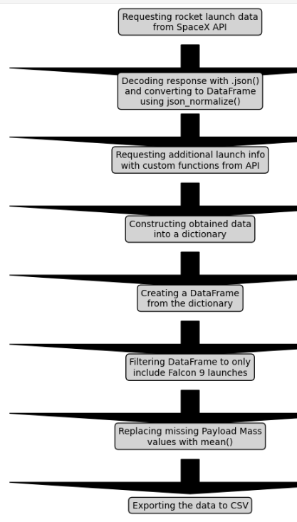
Data Collection – SpaceX API
https://github.com/Minwuye/Data-Science-Capstone-Project/blob/main/Data%20Collection%20API.ipynb

Slide 8
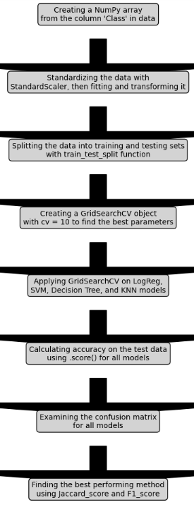
Data Collection – Web scraping
https://github.com/Minwuye/Data-Science-Capstone-Project/blob/main/jupyter-labs-webscraping.ipynb

Slide 9
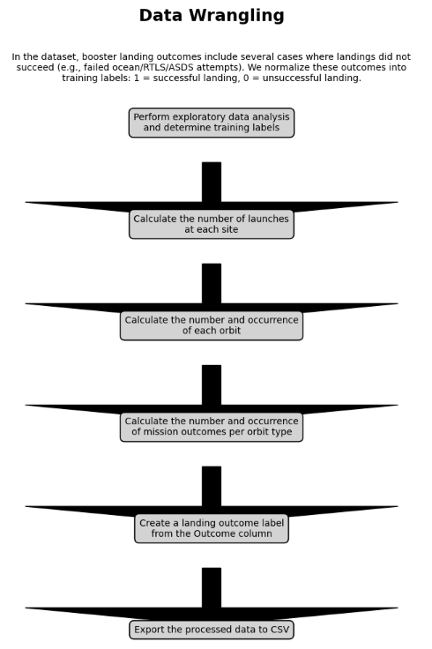
Data Wrangling
https://github.com/Minwuye/Data-Science-Capstone-Project/blob/main/labs-jupyter-spacex-Data%20wrangling.ipynb

Slide 10
EDA with Data Visualization
Several charts were created to explore the dataset, including:
Flight Number vs. Payload Mass
Flight Number vs. Launch Site
Payload Mass vs. Launch Site
Orbit Type vs. Success Rate
Flight Number vs. Orbit Type
Payload Mass vs. Orbit Type
Success Rate Trend by Year
Chart Types and Purpose:
Scatter plots were used to reveal potential relationships between variables, which could inform machine learning models if correlations exist.
Bar charts allowed comparisons across discrete categories, highlighting the relationship between categorical groups and measured outcomes.
Line charts illustrated trends over time, providing insights into yearly patterns and time series behavior.
https://github.com/Minwuye/Data-Science-Capstone-Project/blob/main/edadataviz.ipynb

Slide 11
A series of SQL queries were performed to analyze the dataset, including:
Retrieving the unique names of launch sites used in missions.
Selecting 5 sample records where launch site names start with “CCA”.
Calculating the total payload mass launched by NASA (CRS) missions.
Computing the average payload mass for booster version F9 v1.1.
Identifying the date of the first successful ground pad landing.
Listing boosters that successfully landed on a drone ship with payload masses between 4000 and 6000.
Counting the total number of successful versus failed mission outcomes.
Determining the booster versions that carried the maximum payload mass.
Extracting records of failed drone ship landings in 2015, including booster versions and launch sites.
Ranking landing outcomes (e.g., Failure – drone ship, Success – ground pad) between 2010-06-04 and 2017-03-20, ordered by frequency in descending order.
EDA with SQL
https://github.com/Minwuye/Data-Science-Capstone-Project/blob/main/jupyter-labs-eda-sql-coursera_sqllite.ipynb

Slide 12
Build an Interactive Map with Folium
Launch Site Markers
Plotted the NASA Johnson Space Center as the starting point with a marker, circle overlay, popup, and text label using its latitude/longitude.
Added markers (with circles, popups, and labels) for all launch sites to visualize their locations and their proximity to the equator and coastlines.
Outcome Markers by Site
Used a MarkerCluster to display launch outcomes at each site, with green markers for successful launches and red for failures, highlighting sites with higher success rates.
Proximity Distances from a Launch Site
Drew colored polylines to show distances from KSC LC-39A (example site) to nearby features—railway, highway, coastline, and the closest city.
https://github.com/Minwuye/Data-Science-Capstone-Project/blob/main/lab_jupyter_launch_site_location.ipynb

Slide 13
Build a Dashboard with Plotly Dash
Launch Site Selector
Implemented a dropdown to choose a specific Launch Site.
Success Pie Chart (All Sites / Selected Site)
Displays total successful launches across all sites by default.
When a site is selected, the chart switches to Success vs. Failure counts for that site.
Payload Range Slider
Added a slider to filter records by payload mass range.
Payload vs. Success Scatter Plot
Plotted payload mass against launch outcome across booster versions to visualize the relationship between payload and success rate.
https://github.com/Minwuye/Data-Science-Capstone-Project/blob/main/spacex-dash-app.py

Slide 14
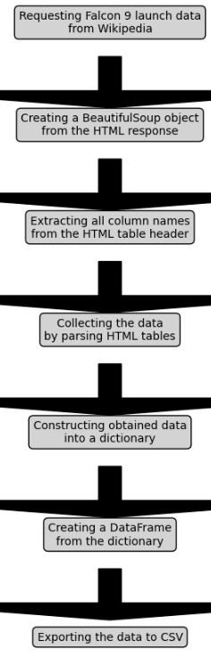
Predictive Analysis - Classification
https://github.com/Minwuye/Data-Science-Capstone-Project/blob/main/SpaceX_Machine%20Learning%20Prediction_Part_5.ipynb

Slide 15
Results
Exploratory data analysis results
Interactive analytics demo in screenshots
Predictive analysis results

Slide 16

EDA with Visualization
Insights drawn
form EDA

Slide 17
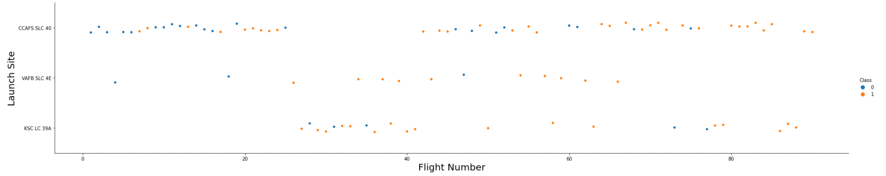
The earliest flights all failed while the latest flights all succeeded.
The CCAFS SLC 40 launch site has about a half of all launches. •
VAFB SLC 4E and KSC LC 39A have higher success rates.
It can be assumed that each new launch has a higher rate of success.
Flight Number vs. Launch Site

Slide 18
Payload vs. Launch Site
For every launch site the higher the payload mass, the higher the success rate.
Most of the launches with payload mass over 7000 kg were successful. • KSC LC 39A has a 100% success rate for payload mass under 5500 kg too

Slide 19
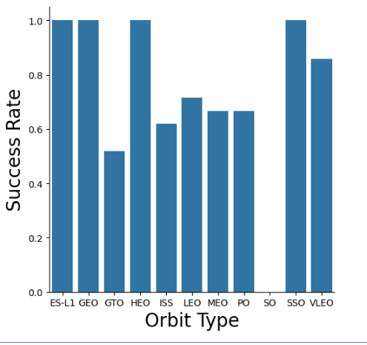
Success rate vs. Orbit type
Orbits with 100% success rate: - ES-L1, GEO, HEO, SSO
Orbits with 0% success rate: - SO • Orbits with success rate between 50% and 85%: - GTO, ISS, LEO, MEO, PO

Slide 20
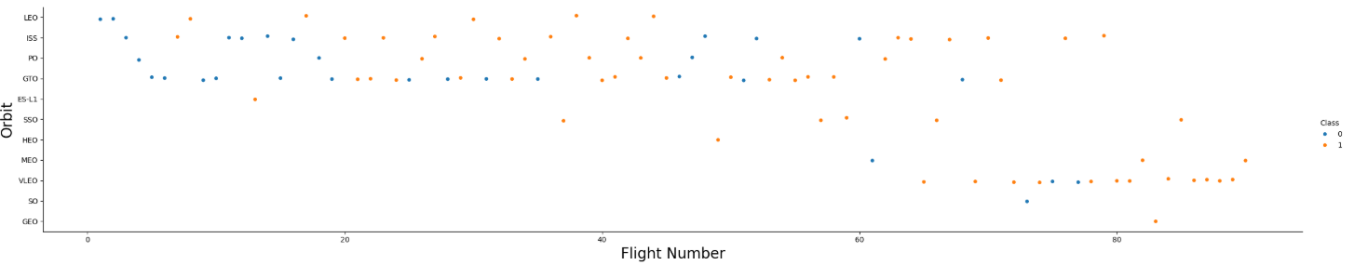
Flight Number vs. Orbit Type
In the LEO orbit the Success appears related to the number of flights; on the other hand, there seems to be no relationship between flight number when in GTO orbit.

Slide 21
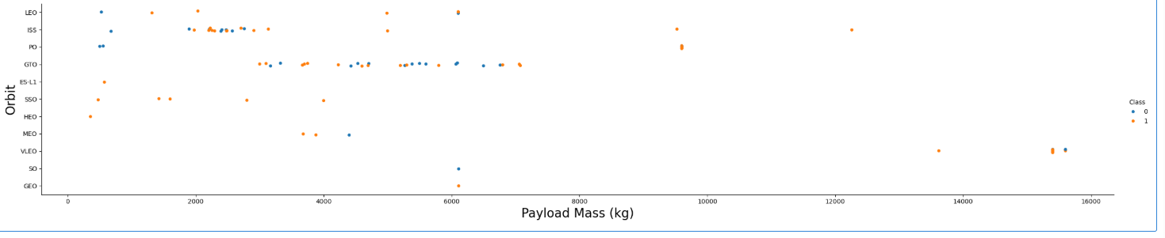
Payload Mass vs. Orbit type
Heavy payloads have a negative influence on GTO orbits and positive on GTO and Polar LEO (ISS) orbits.

Slide 22
Launch Success Yearly Trend
The success rate since 2013 kept increasing till 2020.

Slide 23
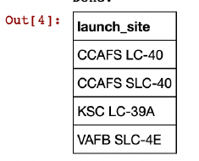
All Launch Site Names
Displaying the names of the unique launch sites in the space mission.

Slide 24
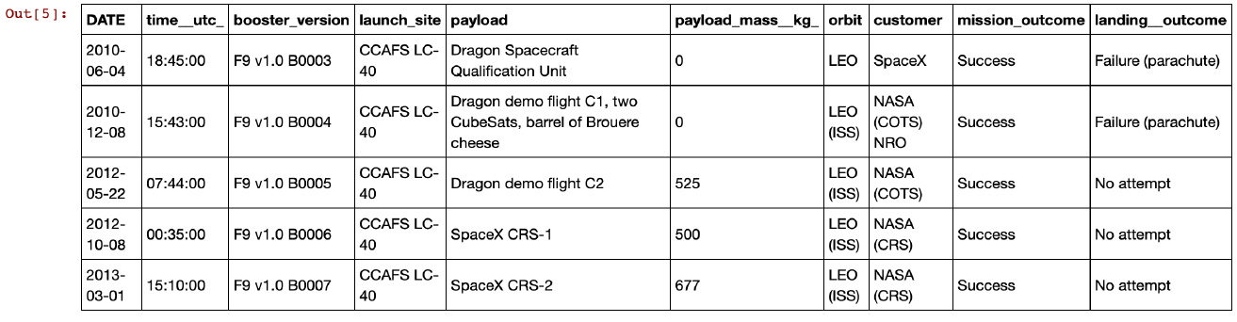
Displaying 5 records where launch sites begin with the string 'CCA'.
Launch site names begin with `CCA`

Slide 25
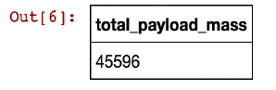
Total Payload Mass
Total payload mass

Slide 26
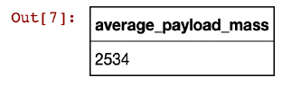
Average Payload Mass by F9 v1.1
Average payload mass

Slide 27
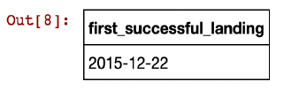
First Successful Ground Landing Date
The 1st successful landing

Slide 28
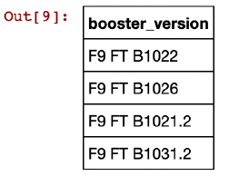
Successful Drone Ship Landing with Payload between 4000 and 6000
4 types of boosters with successful drone ship landing with payload 4000-6000

Slide 29
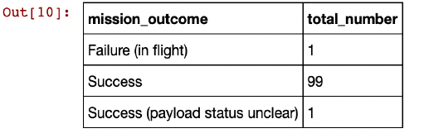
Total Number of Successful and Failure Mission Outcomes
Close to 99% success rate

Slide 30
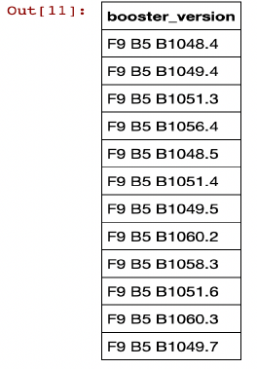
Boosters Carried Maximum Payload
12 types of boosters with max payload

Slide 31
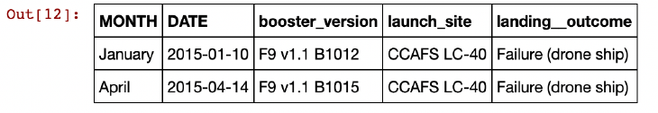
2015 Launch Records
2 failures in 2015

Slide 32
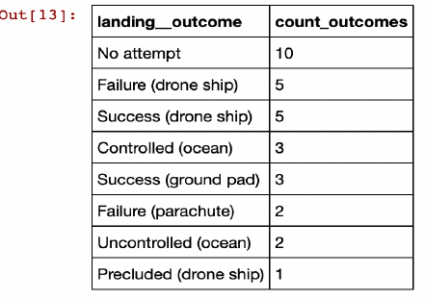
Rank Landing Outcomes Between 2010-06-04 and 2017-03-20
Ranking the count of landing outcomes (such as Failure (drone ship) or Success (ground pad)) between the date 2010-06-04 and 2017-03-20 in descending order.

Slide 33

Launch site proximities analysis
Folium analysis

Slide 34
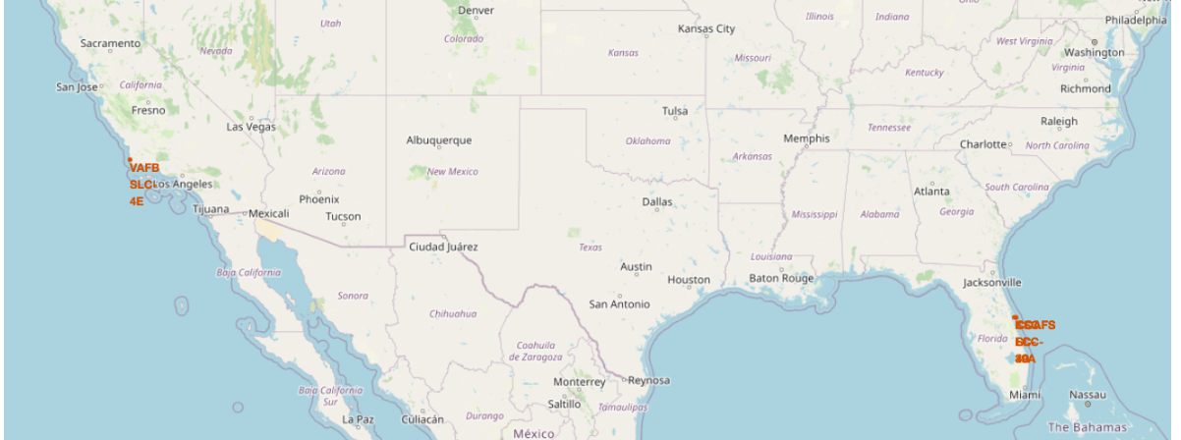
Most rocket launch sites are located near the equator.
This is because the Earth rotates fastest at the equator, where the surface already moves at about 1,670 km/h.
When a spacecraft is launched from this region, it carries that same speed due to inertia, which helps it reach and maintain orbital velocity.
Additionally, launch sites are usually positioned close to coastlines so rockets can be launched over the ocean.
This reduces the danger of falling debris or explosions affecting populated areas.
All launch sites’ location markers on a global map

Slide 35
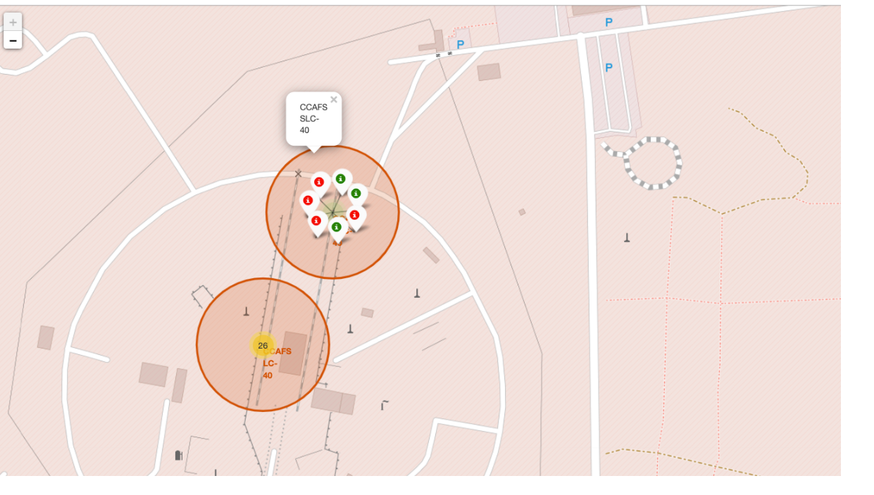
From the colour-labeled markers we should be able to easily identify which launch sites have relatively high success rates.
Green Marker = Successful Launch
Red Marker = Failed Launch
Color-labeled launch outcomes on the map

Slide 36
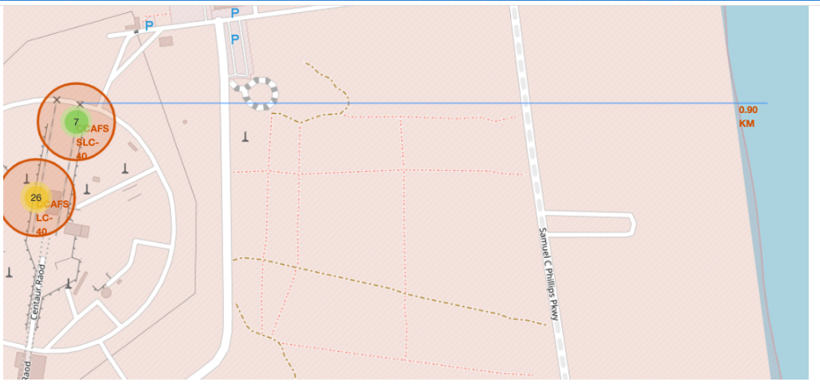
launch site to its proximities such as railway, highway, coastline

Slide 37

Build a Dashboard with Plotly Dash

Slide 38
Launch success count for all sites
The chart clearly shows that from all the sites, KSC LC-39A has the most successful launches.

Slide 39
Launch site with highest launch success ratio
KSC LC-39A has the highest launch success rate (76.9%) with 10 successful and only 3 failed landings.

Slide 40
Payload Mass vs. Launch Outcome for all sites
The charts show that payloads between 2000 and 5500 kg have the highest success rate.

Slide 41

Predictive analysis (Classification)

Slide 42
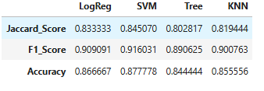
Classification Accuracy
Visualize the built model accuracy for all built classification models, in a bar chart
The scores of the whole Dataset
confirm that the best model is the
SVM Model, in all the evaluation ,metrics
Scores and Accuracy of the Entire Data Set

Slide 43
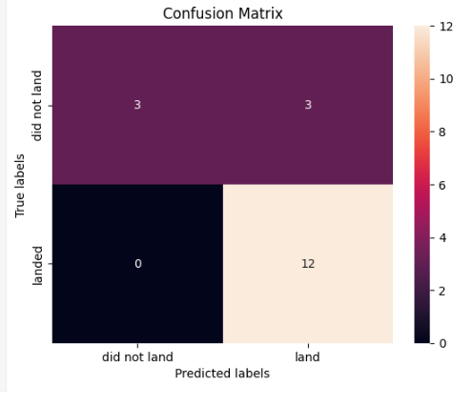
Confusion Matrix
This best model has some draw back in classifying the FP, the others TN, TP and FN were correctly identified.

Slide 44

Conclusions
Best model: An SVM performed best on this dataset.
Payload effect: Lower payload mass correlates with higher launch success.
Geography: Most launch sites sit near the equator and very close to coasts.
Time trend: Success rates improve year over year.
Top site: KSC LC-39A shows the highest success rate among sites.
Orbit types: ES-L1, GEO, HEO, SSO show 100% success in this sample.

Slide 45

Thank you!!
To my instructors, IBM, and Coursera!!!
https://github.com/Minwuye/Data-Science-Capstone-Project.git

